Slide 1
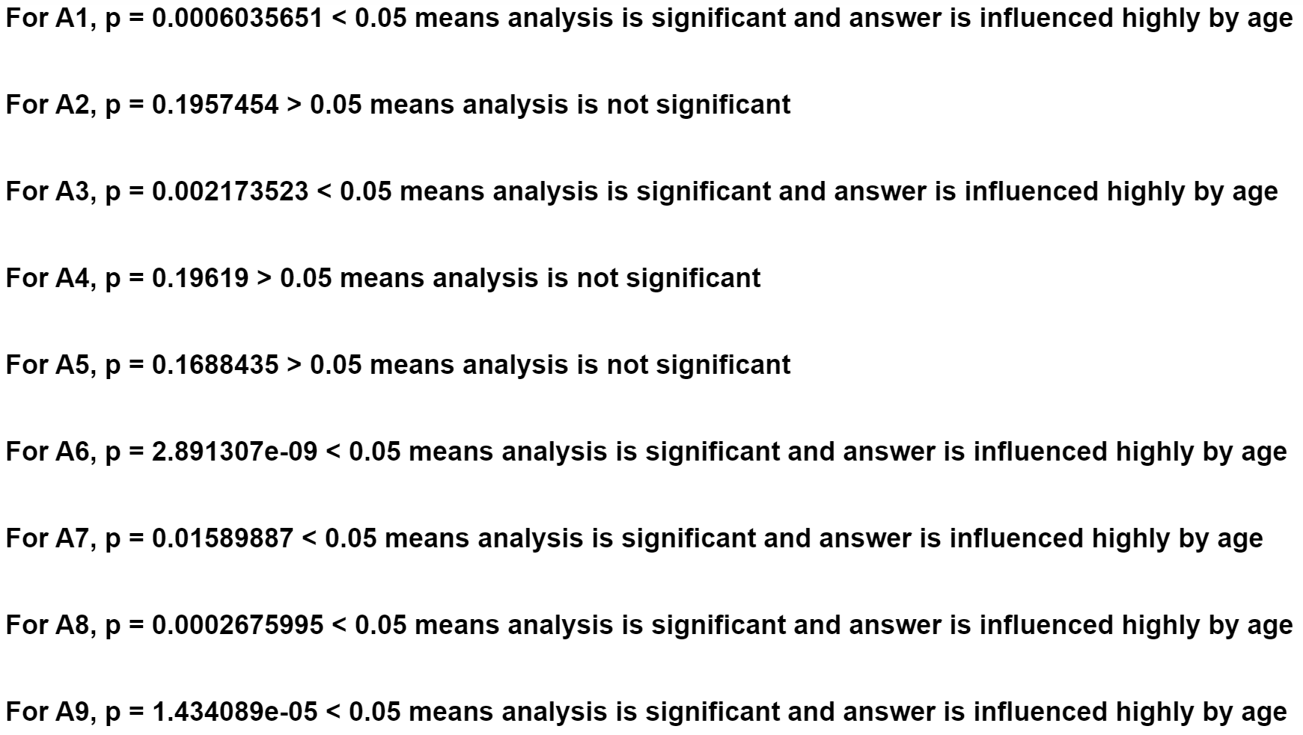
Independent Chi-Squares’ statistics on Child, Adolescent and Adult data sets:
Assumption of Independent data and Expected Frequency is met , i.e., expected frequency in each cell is >5
Based on Pearsons Chi-Squared test result:

